Slide 1
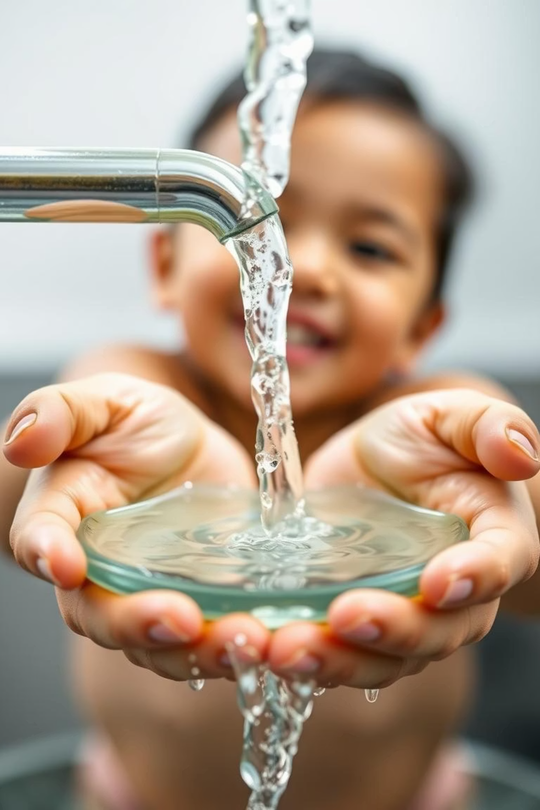
WASH Access and Child Mortality
Done by Yvette
Janviere
Josiane and
Solange

Slide 2
Project Introduction
Access to safe drinking water and adequate sanitation is a fundamental human right and crucial for sustainable development and public health. Despite global improvements, many low- and middle-income countries still struggle with universal access, leading to preventable health issues, especially among children under five.
This project uses WHO/UNICEF JMP and World Bank datasets to analyze how improved WASH services correlate with child mortality, aiming to inform public health strategies and advance SDG 6: Clean Water and Sanitation for All.

Slide 3
Project Progress Overview
Week 1: Completed Tasks
Week 2: Current Focus
Understood JMP and WDI dataset structure and context.
Exploratory Data Analysis (EDA) in progress.
Visualizations created: line charts, heatmaps, bar graphs, scatter plots.
Successfully downloaded relevant datasets.
Cleaned, standardized, and merged datasets.
Statistical tests: Pearson's r correlation analysis performed.
Preliminary results show strong negative correlation between WASH access and child mortality.
Regression analysis in progress to model predictive relationship.
Documentation and reporting underway.

Slide 4
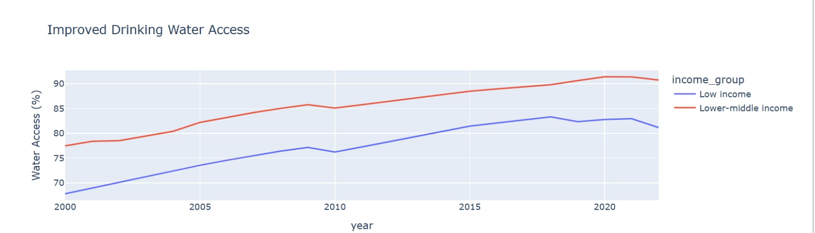
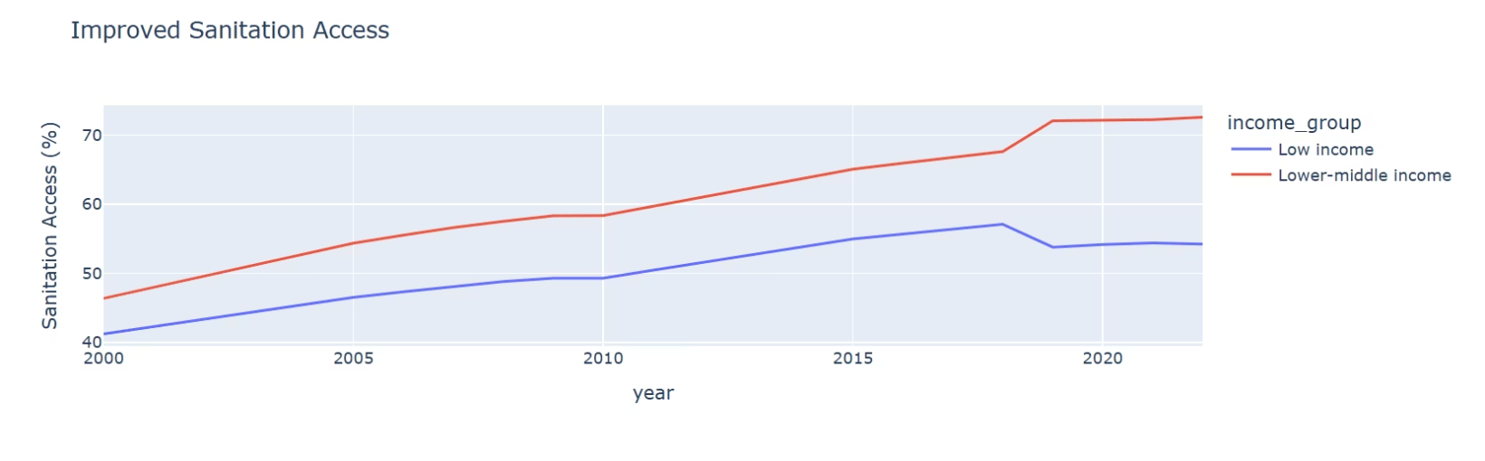
Key Insights: Trends and Relationships
How water access trends over time
How sanitation trends over time
In 2000, (low-income countries) had water access of 67.8%. And in 2022, had 81.1%
In 2000,(lower-middle income) had water access of 77.4% and in 2022, had 90.7%
In 2000, (low-income countries) had Sanitation access of 41.2%. And in 2022, had 54.2%
In 2000,(lower-middle income) had Sanitation access of 46.3% and in 2022, had 72.5%

Slide 5
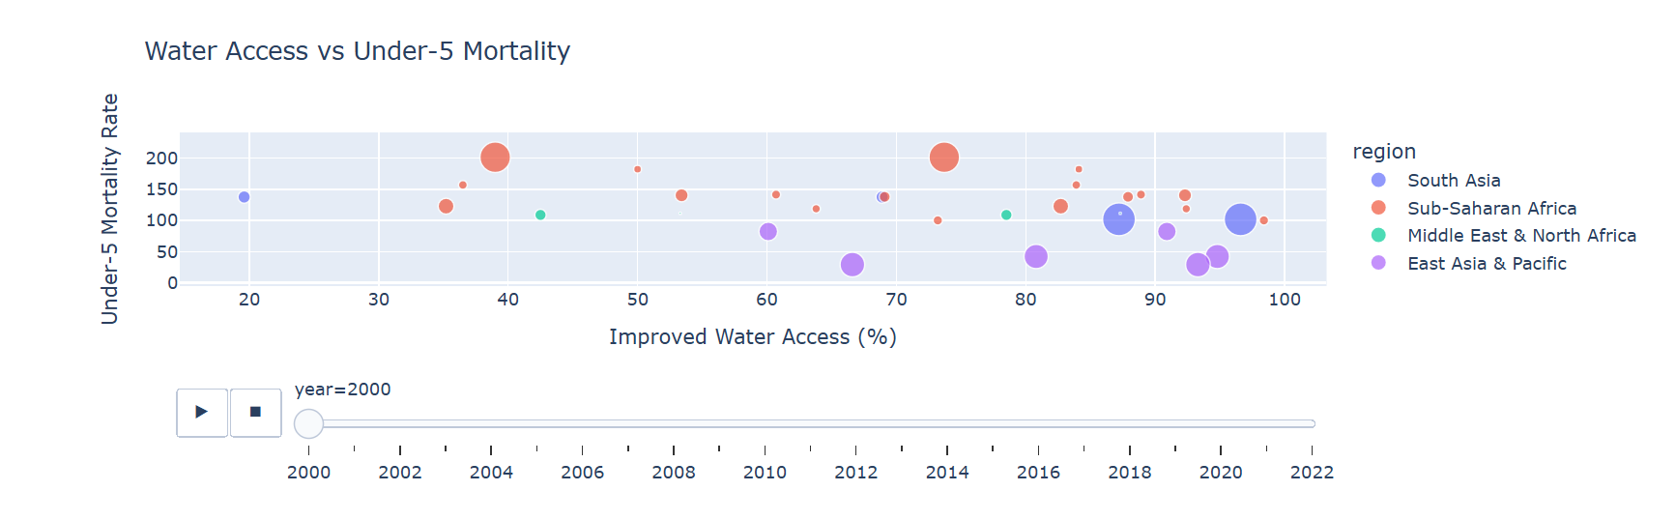
Key Insights: Trends and Relationships
Water Access vs. Under-5 Mortality
I
In 2000 Afghanistan (South Asia) achieved 19.6% improved water access with 137.6 under_5 mortality.
In 2022, Pakistan (South Asia) achieved 99.2% improved water access with 0 under-5 mortality.

Slide 6
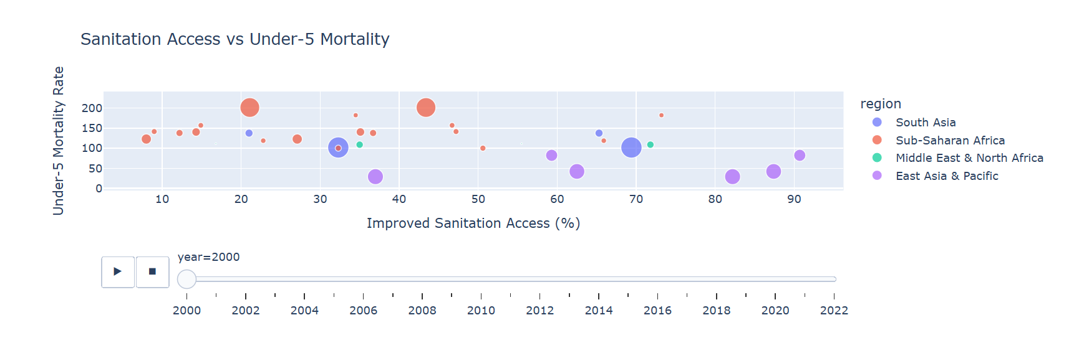
Key Insights: Trends and Relationships
Sanitation Access vs. Under-5 Mortality
In 2000, Tanzania (Sub-Saharan Africa) had 8% improved sanitation access with 122.9 under-5 mortality .
In 2022, the Philippines (East Asia & Pacific) had 93.5% improved sanitation access with 0 under-5 mortality.

Slide 7
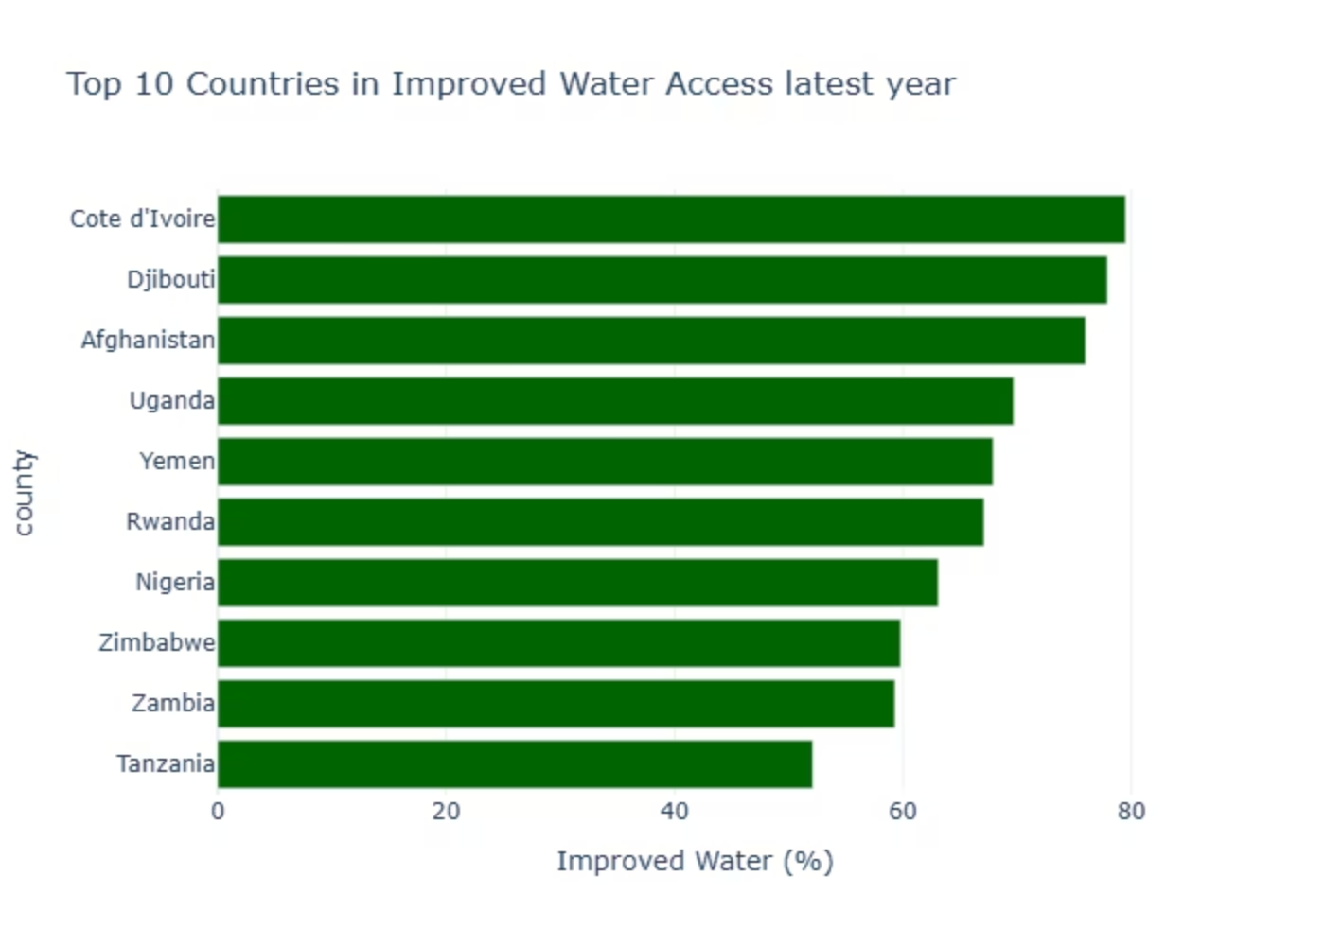
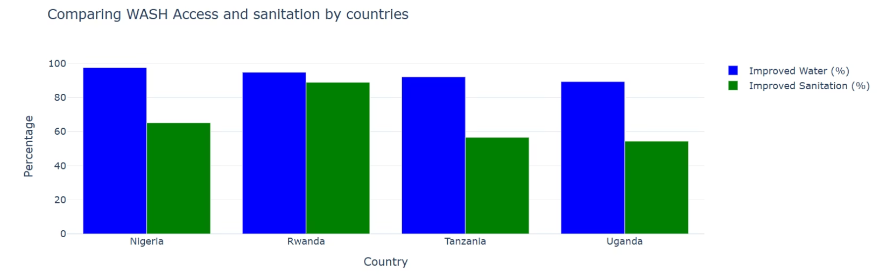
Key Insights: Country Comparisons
Top 10 Countries with Improved Water Access
WASH Access and Sanitation by Country
Côte d'Ivoire shows the highest improved water access, while Tanzania has the lowest among the top 10.
Nigeria leads in improved water and sanitation access, followed by Rwanda. Uganda has the lowest access.

Slide 8
Statistical Test Results
Normality Check (Shapiro-Wilk Test)
T-test Results
Improved Water and Sanitation for Low and Lower-Middle Income groups are normally distributed (p = 0.000).
Statistically significant difference in improved water access (t = -7.061, p = 0.000) and sanitation access (t = -5.576, p = 0.000).

Slide 9
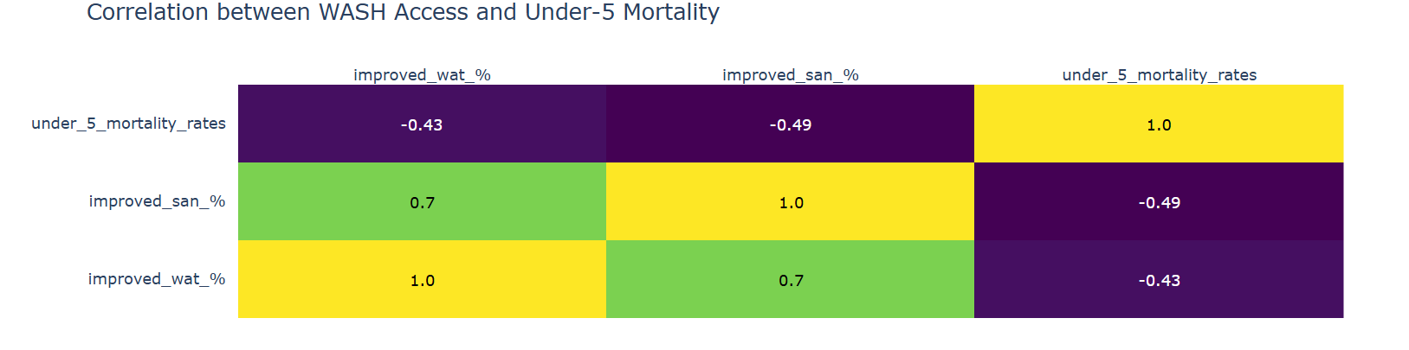
Correlation Analysis
Using Spearman correlation due to non-normal data, we found:
Improved Water vs. Under-5 Mortality: r = -0.444, p = 0.0000
Improved Sanitation vs. Under-5 Mortality: r = -0.511, p = 0.0000
This indicates a negative correlation: as WASH access improves, under-5 mortality rates tend to decrease.

Slide 10

Recommendations
1.Prioritize WASH Infrastructure in Low-Income .
2.Countries Focus on High-Impact Regions .
3. Monitor SDG 6 Progress with Real-Time Tools .

Slide 11

Conclusion and Next Steps
Our findings show that better access to clean water and sanitation (WASH) helps reduce child deaths. But many poor countries, especially in Sub-Saharan Africa, still lack these basic services. This is not just about numbers, real children are dying from preventable causes. To reach global goals like SDG 6, we need smart, targeted investments in WASH. Every child deserves clean water and a chance to live.
Conclusion and Next Steps
Interactive Dashboard for WASH & Child Mortality
Insights Final Project Report Summary

